Slide 1
Kiva Team Analysis
IEOR 290C Semester Project
Q.W. Y.X. Y.B. Y.D.

Slide 2

Overview
Getting Data
Mapping
Kiva Team
Graphs
Regression

Slide 3

What is ?
A non-profit organization with a mission to connect people through lending to alleviate poverty

Slide 4
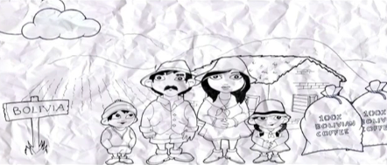

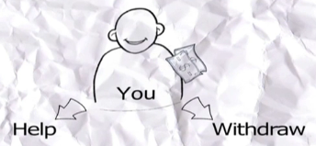
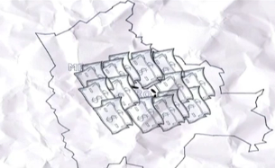
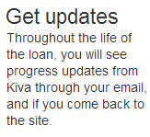
How works

Slide 5
KivaTeam
http://www.kiva.org/teams

Slide 6
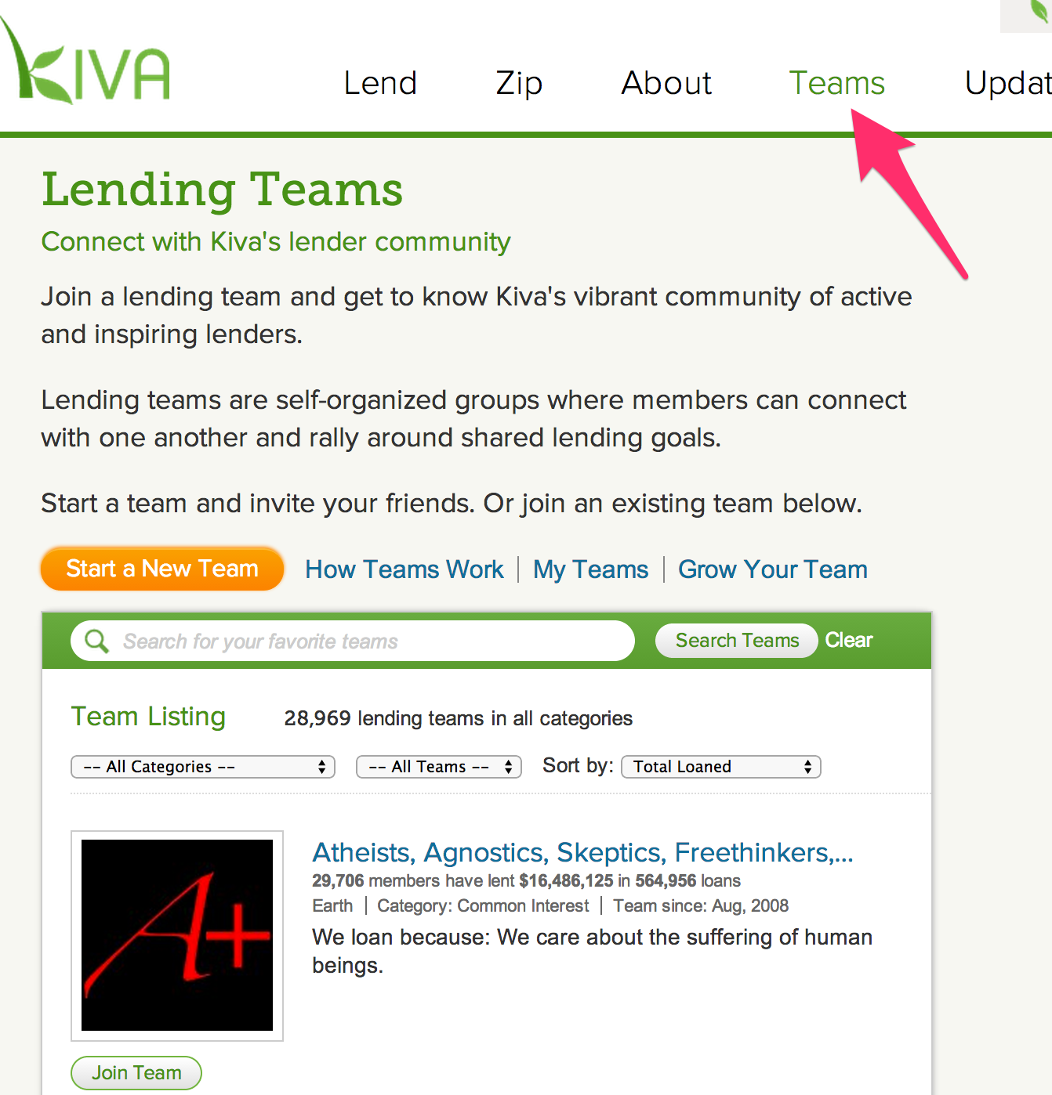
Teams Page
Notes:
Responsible for scrapping information from each team

Slide 7
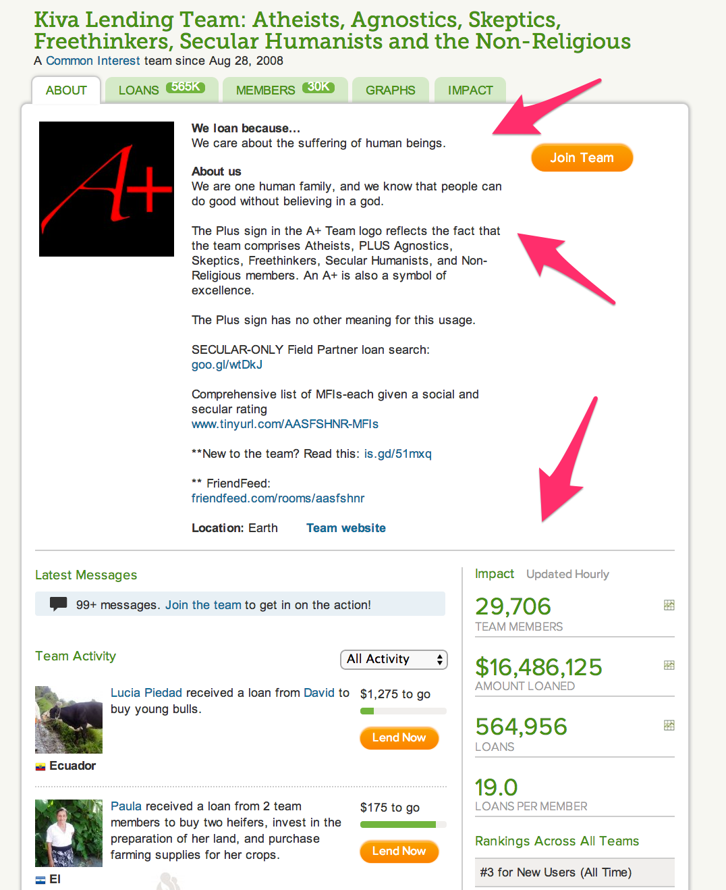
About
Notes:
Team intro
Team about
Impact column

Slide 8
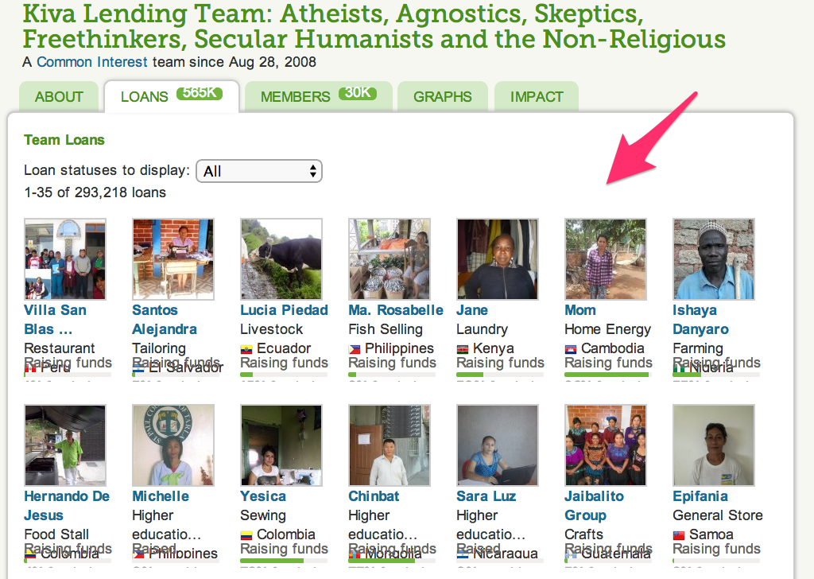
Loan members page
Notes:
Loan members – people who borrow money from the team

Slide 9
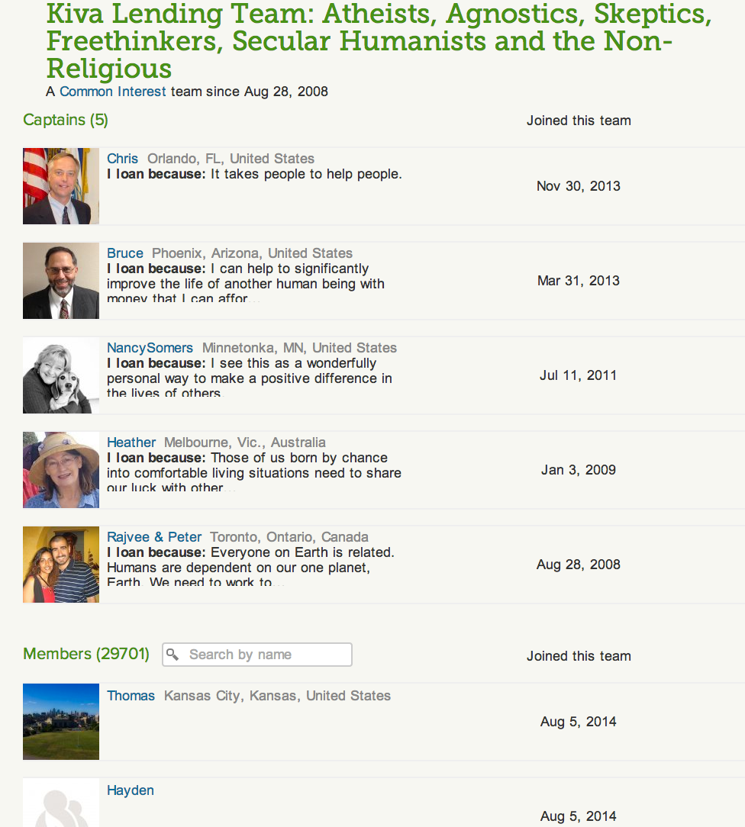
Member’s page of each team
Notes:
Team members

Slide 10
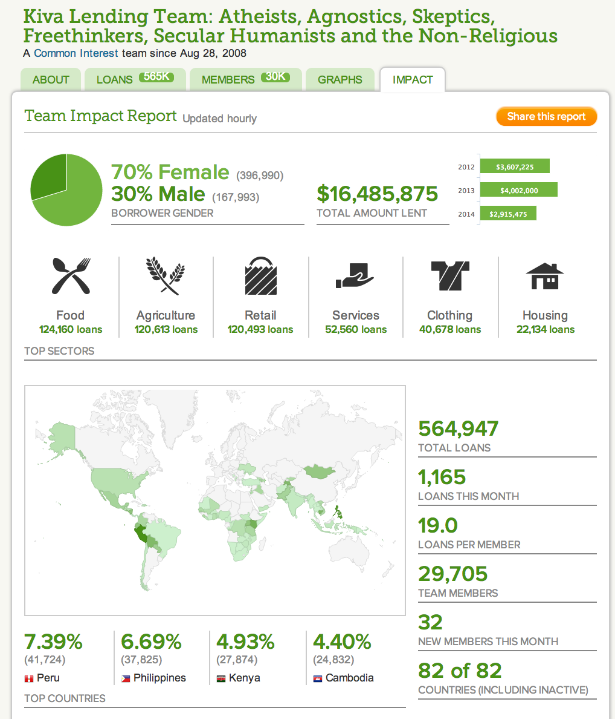
Impact’s page of each team
Notes:
Team impact

Slide 11
Web scrapping
Code Structure:
KivaTeam Class
Dictionaries
Functions
Notes:
Simple code structure
Kiva team team with dictionaries and functions to scrape and store information about each team
Stored these information into csv files for further analysis

Slide 12
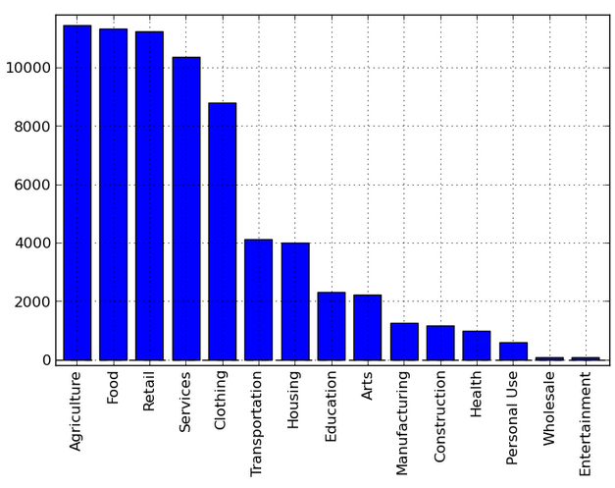
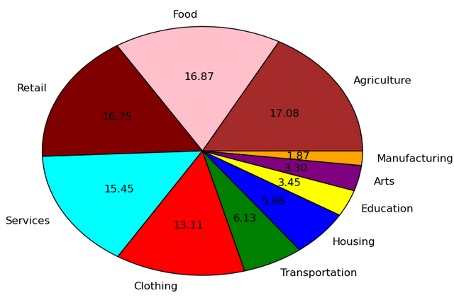
Campaign Categories

Slide 13
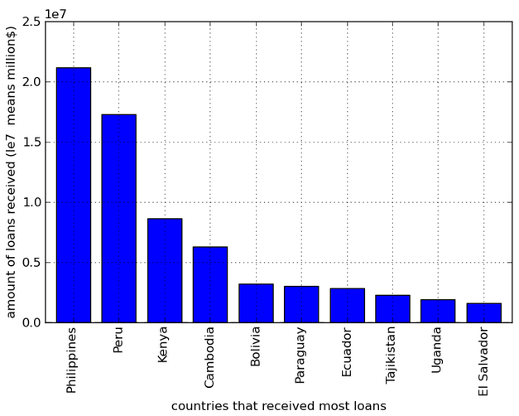
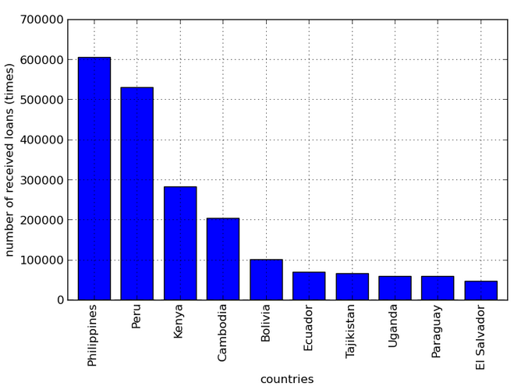
Countries that receive most loans

Slide 14
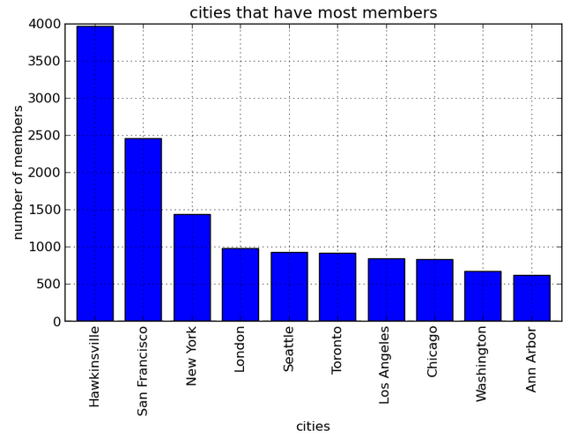
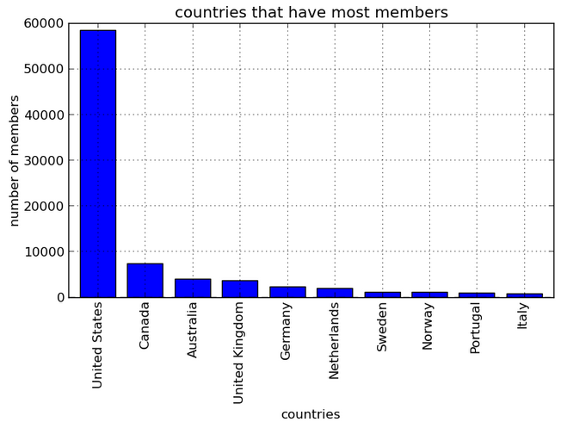
Countries and cities that have most members

Slide 15
Comment
The reason why a small town called Hawkinsville in Georgia has so many members is that a Kiva member called Benjamin from Hawkinsville joined thousands of teams, and the way we count members is scrapping the members from each team and add them up together. Since we didn’t write a checking system to find out the ones who join multiple teams, Hawkinsville is double-counted thousands of times.

Slide 16
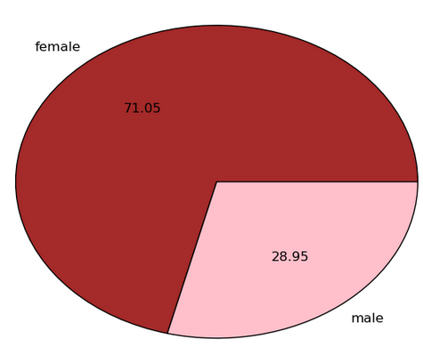
There are more women come to Kiva to ask for support

Slide 17
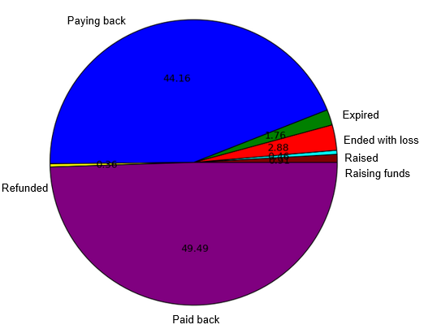
How Kiva is doing?
Paid back 289959
Paying back 258742
Ended with loss 16863
Expired 10305
Raising funds 5306
Raised 2687
Refunded 2090
Notes:
This needs to be improved. What data is included, how is this data gathered, etc. bullet points

Slide 18
Comment
Note that Kiva claims 98% repayment rate. However, our data shows that only a small percentage of loans are actually repaid
This is due to the fact that we did not scrape data from the loans page randomly. It is very likely that Kiva Team website organizes in a way such that loans that teams which are raising funds are displayed first and we only scrapped the first ten pages (due to timing)

Slide 19
Regression
Loans per member V.S Total amount lent
Total loans V.S Total amount lent
Borrow female count V.S Total amount lent
Borrow male count V.S Total amount lent
Introduction length V.S Total amount lent
Notes:
Needs to identify what the outliers are. Mention that teams also include companies and groups (registering as one user)

Slide 20
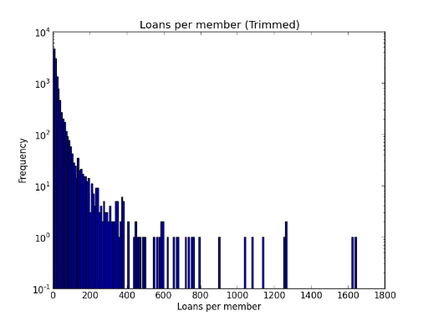
Loans per member V.S Total amount lent
Min of loans per members | 0.20
Max of loans per members | 88723.00
Mode of loans per member | 4.0
Median of loans per members | 11.00
Mean of loans per members | 33.47
Std deviation of loans per members | 830.39
Number of loans per member outliers | 8
Divisions 0.2 to 8.429 has the maximum count of 4679

Slide 21
Comments
Total number of outliers: 8
Most of outliers are one group or single company making loans to a large number of people.
Thus the loans per number is very large

Slide 22
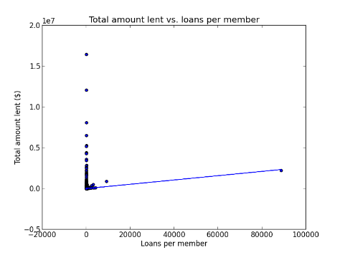
coef std err t P>|t| [95.0% Conf. Int.] Intercept 1.983e+04 2371.573 8.360 0.000 1.52e+04 2.45e+04 loans_per_member 26.2967 2.854 9.215 0.000 20.703 31.891
Interference:
There is no relationship between loans per member and total amount lent. Because the amount of team members in each team is different.
R-squared: 0.007
Adj. R-squared: 0.007

Slide 23
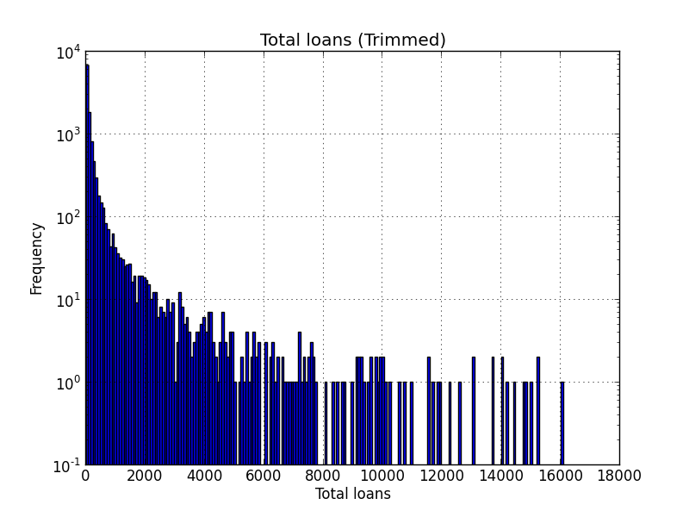
Total loans V.S Total amount lent (for each team)
Min of total loans | 6
Max of total loans | 563732
Mode of total loans | 16
Median of total loans | 64.00
Mean of total loans | 640.64
Std deviation of total loans | 7826.24
Number of total loans outliers | 60
Divisions 6.0 to 86.505 has the maximum count of 6834

Slide 24
Comments
Total number of outliers: 60
Some team such as Atheists, HP and Milepoint have large number of loans out standing due to their large team size, popularity and commitment

Slide 25
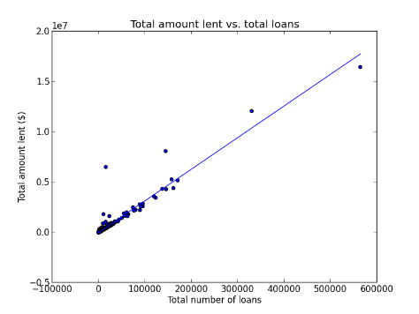
coef std err t P>|t| [95.0% Conf. Int.] Intercept 535.7859 671.535 0.798 0.425 -780.536 1852.108 total_loans 31.4862 0.086 368.160 0.000 31.319 31.654
It shows that the total amount and total loans (times of loans) for each lending team are positive correlated.
R-squared: 0.921
Adj. R-squared: 0.921

Slide 26
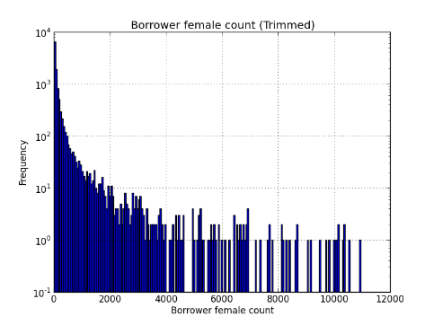
Borrow female count V.S Total amount get (for each borrow campaign)
Min of borrower female count | 3
Max of borrower female count | 396131
Mode of borrower female count | 11
Median of borrower female count | 46.00
Mean of borrower female count | 455.24
Std deviation of borrower female count | 5454.84
Number of borrower female count outliers | 61
Divisions 3.0 to 57.72 has the maximum count of 6621

Slide 27
Comments
Total number of outliers: 61
Most outliers are teams with high number of loans outstanding

Slide 28
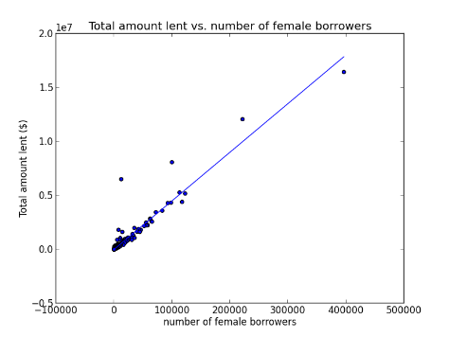
coef std err t P>|t| [95.0% Conf. Int.] Intercept 177.4254 684.934 0.259 0.796 -1165.161 1520.012 borrower_female_count 45.0965 0.125 360.383 0.000 44.851 45.342
Inference:
If there is one more female in each borrow campaign, then that campaign is likely to get $45 more in average.
R-squared: 0.918
Adj. R-squared: 0.918

Slide 29
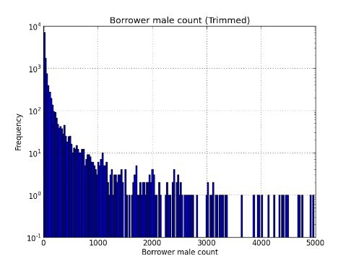
Borrow male count V.S Total amount get (for each borrow campaign)
Min of borrower male count | 1
Max of borrower male count | 167631
Mode of borrower male count | 3
Median of borrower male count | 16.00
Mean of borrower male count | 185.45
Std deviation of borrower male count | 2395.98
Number of borrower male count outliers | 55
Divisions 1.0 to 25.835 has the maximum count of 7177

Slide 30
Comments
Total number of outliers: 55
Most outliers are teams with high number of loans outstanding

Slide 31
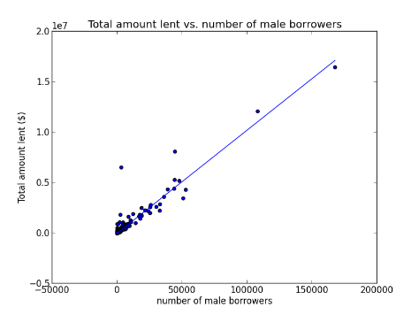
coef std err t P>|t| [95.0% Conf. Int.] Intercept 1750.6078 717.131 2.441 0.015 344.911 3156.305 borrower_male_count 102.2201 0.298 342.531 0.000 101.635 102.805
Inference:
If there is one more male in each borrow campaign, then that campaign is likely to get $102 more in average.
R-squared: 0.910
Adj. R-squared: 0.910

Slide 32
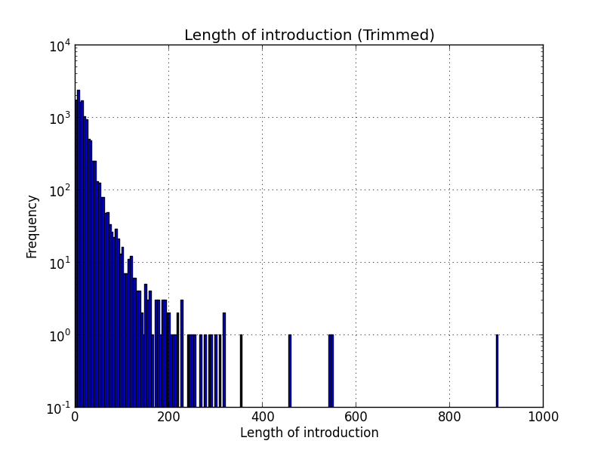
Introduction length V.S Total amount lent

Slide 33
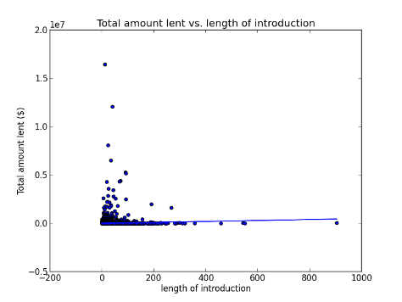
coef std err t P>|t| [95.0% Conf. Int.] Intercept 1.126e+04 2987.940 3.767 0.000 5399.396 1.71e+04 intro_len 501.6788 96.208 5.215 0.000 313.094 690.263
Inference:
There is no relationship between the length of description and the amount of money they get.
R-squared: 0.002
Adj. R-squared: 0.002

Slide 34
Regression Summary
The total amount of loans ($) a team makes is closely associated with the total number of loans a team makes but not so much on number of loans per number
This is because a very large group of people or a single company will register as a single user

Slide 35
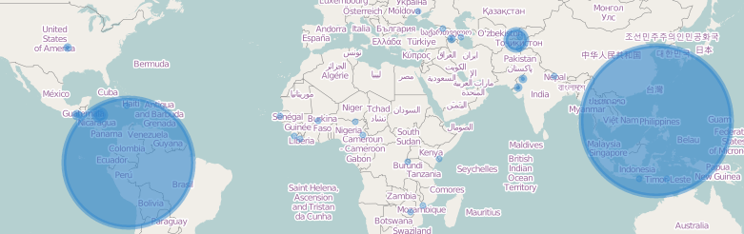
Loans Located
Map demonstrate which countries the loans go into

Slide 36
Comment: Why Peru and Philippines
In Peru, there are many local non-profit organizations are cooperating with Kiva to promote microfinance. For example, there is a organization called FINCA Peru has a partnership with Kiva, they work together and obtained $4.7 million in repaid loans.
In Philippines, besides the local promotion and cooperation with organizations like ASKI, one main reason why Kiva is doing so well is that language. The official languages in Philippines are Filipino and English. Thus, it is much easier for Philippines to describe their campaign and ask for loans.

Slide 37
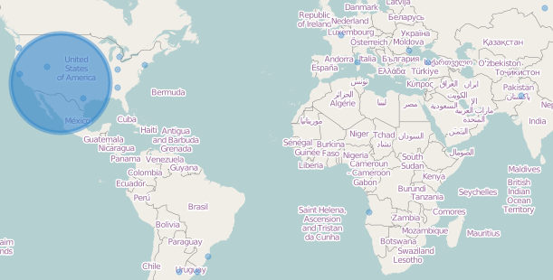
Members Located
Map demonstrate where members of each team are located

Slide 38
Thank you
Questions?

